Slide 1


SWIGGY DATA ANALYSIS
SUBMITTED BY:
M. BALAJI

Slide 2
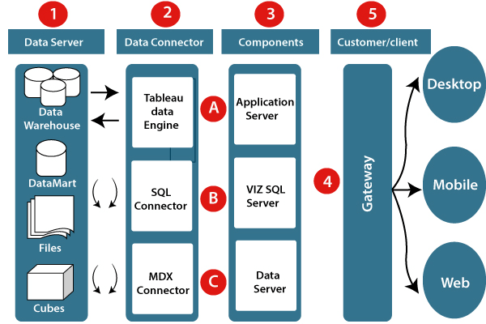
ARCHITECTURE

Slide 3
ETL OPERATIONS
Cleaning poorly formatted columns from the extracted raw data.
Skipping rows with Nan values.
Removing duplicated rows.
Changing the data types for necessary columns.

Slide 4
INSIGHTS

Slide 5
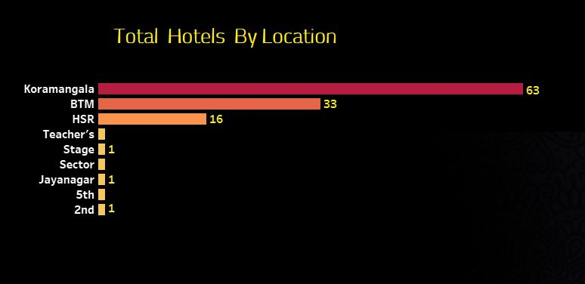
Locations with more number of shops are:
Koramangala - 63
BTM - 33
HSR - 16

Slide 6
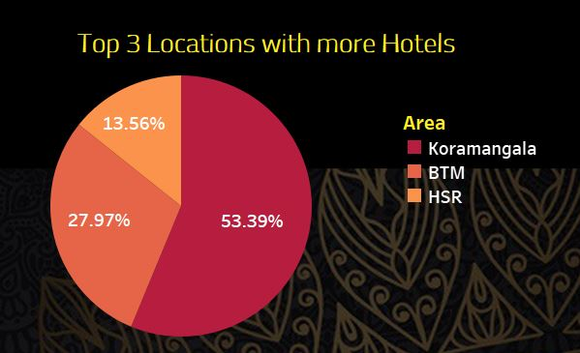
Koramangala location has more i.e, 53.39 % of availability of hotels

Slide 7
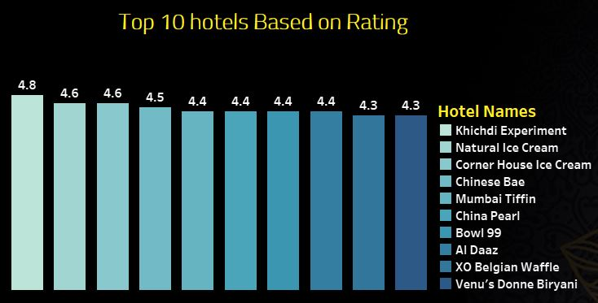
Khichdi Experiment has highest rating of 4.8 with a Price of 100/- per item.
Corner House Ice Cream and Natural Ice Cream are the shops with 4.6 rating, with the prices of 125/- and 75/-

Slide 8
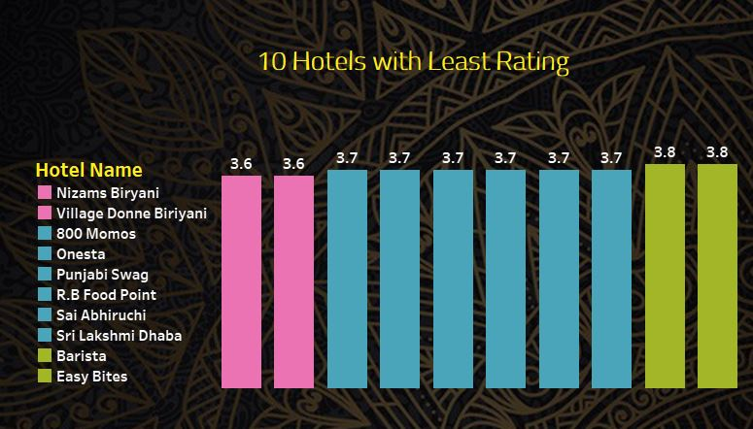
Nizam’s Biryani & Village Donne Biryani has least rating of 3.6

Slide 9
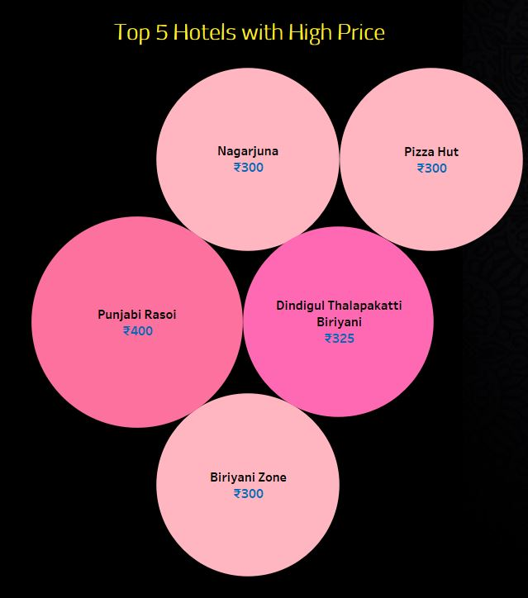
Punjabi Rasoi hotel has highest price of 400/- among all the hotels in Bangalore

Slide 10
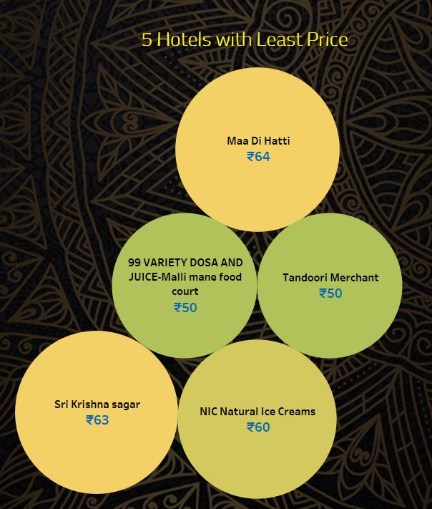
99 Variety Dosa & Tandoori Merchant hotels has least price of 50/- among all the hotels in Bangalore

Slide 11
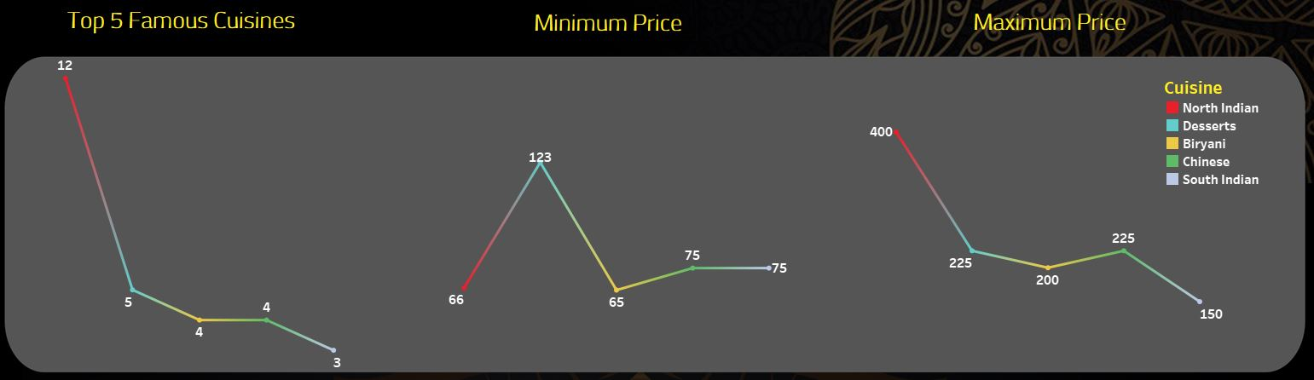
This page gives details about:
Top 5 Famous Cuisines
Minimum price of famous Cuisines
Maximum price of famous Cuisines

Slide 12
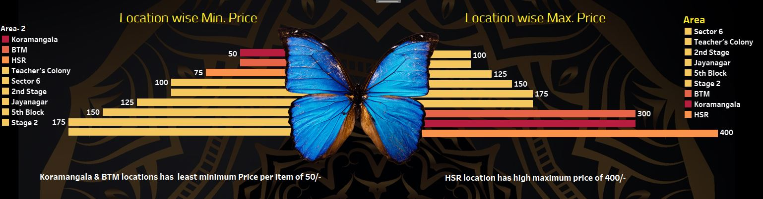
This page gives details about Minimum & Maximum price per item based on Location

Slide 13
Q & A
What's the Source of the Data - Collected from Given Data Set
Which tools you are used in this entire project – Tableau Public
How did you deploy the report - The report was deployed in my Tableau Public Server
What was the type of Data - Numerical and Categorical Values

Slide 14
THANK YOU

